Slide 1
moose for dcs world SCORING

Slide 2
scoring

Slide 3
why a scoring class in moose?
Independent scoring logic from DCS.
Positive scores and negative penalties make a total score.
Objects scored are Units, Statics and Scenery.
Log the scoring in CSV files for statistics on web sites.
Automatic calculation of scores based on:
the threat level of the object destroyed.
the threat level of the player destroying the object.
Score achievements:
Grant additional scores when players destroy specific objects.
Specify destruction zones where additional scores are granted when objects are destroyed.
Display messages when scores are achieved by players. Messages can be customized:
Define the target audience of the messages, which can be all players or the coalition.
Switch messages on/off for specific events (hit, destroy, specific, zone).
Grant scores or penalties at specific events to players.
Scale the scores for specific missions.
Set a level of fratricide. Players cannot just go on shooting friendlies.
Reporting system during a running mission that players can consult. Various reporting levels.

Slide 4
score is calculated based on threat level
TARGET
Threat | 0 | 1 | 2 | 3 | 4 | 5 | 6 | 7 | 8 | 9 | 10
0 | 0 | 1 | 2 | 3 | 4 | 5 | 6 | 7 | 8 | 9 | 10
1 | 0 | 1 | 2 | 3 | 4 | 5 | 6 | 7 | 8 | 9 | 10
2 | 0 | 1 | 2 | 3 | 4 | 5 | 5 | 6 | 7 | 8 | 9
3 | 0 | 1 | 2 | 3 | 4 | 4 | 5 | 6 | 7 | 7 | 8
4 | 0 | 1 | 2 | 3 | 3 | 4 | 5 | 5 | 6 | 7 | 8
5 | 0 | 1 | 2 | 2 | 3 | 4 | 4 | 5 | 6 | 6 | 7
6 | 0 | 1 | 2 | 2 | 3 | 4 | 4 | 5 | 5 | 6 | 7
7 | 0 | 1 | 2 | 2 | 3 | 3 | 4 | 5 | 5 | 6 | 6
8 | 0 | 1 | 2 | 2 | 3 | 3 | 4 | 4 | 5 | 5 | 6
9 | 0 | 1 | 2 | 2 | 3 | 3 | 4 | 4 | 5 | 5 | 6
10 | 0 | 1 | 1 | 2 | 2 | 3 | 3 | 4 | 4 | 5 | 5
PLAYER

Slide 5


scores are granted upon hits and shared upon destroy
Destroy Score
Hit Score
Hit
Destroy
Destroy Score
Hit Score
Hit
Hit
Destroy
Destroy Score
Hit Score

Slide 6
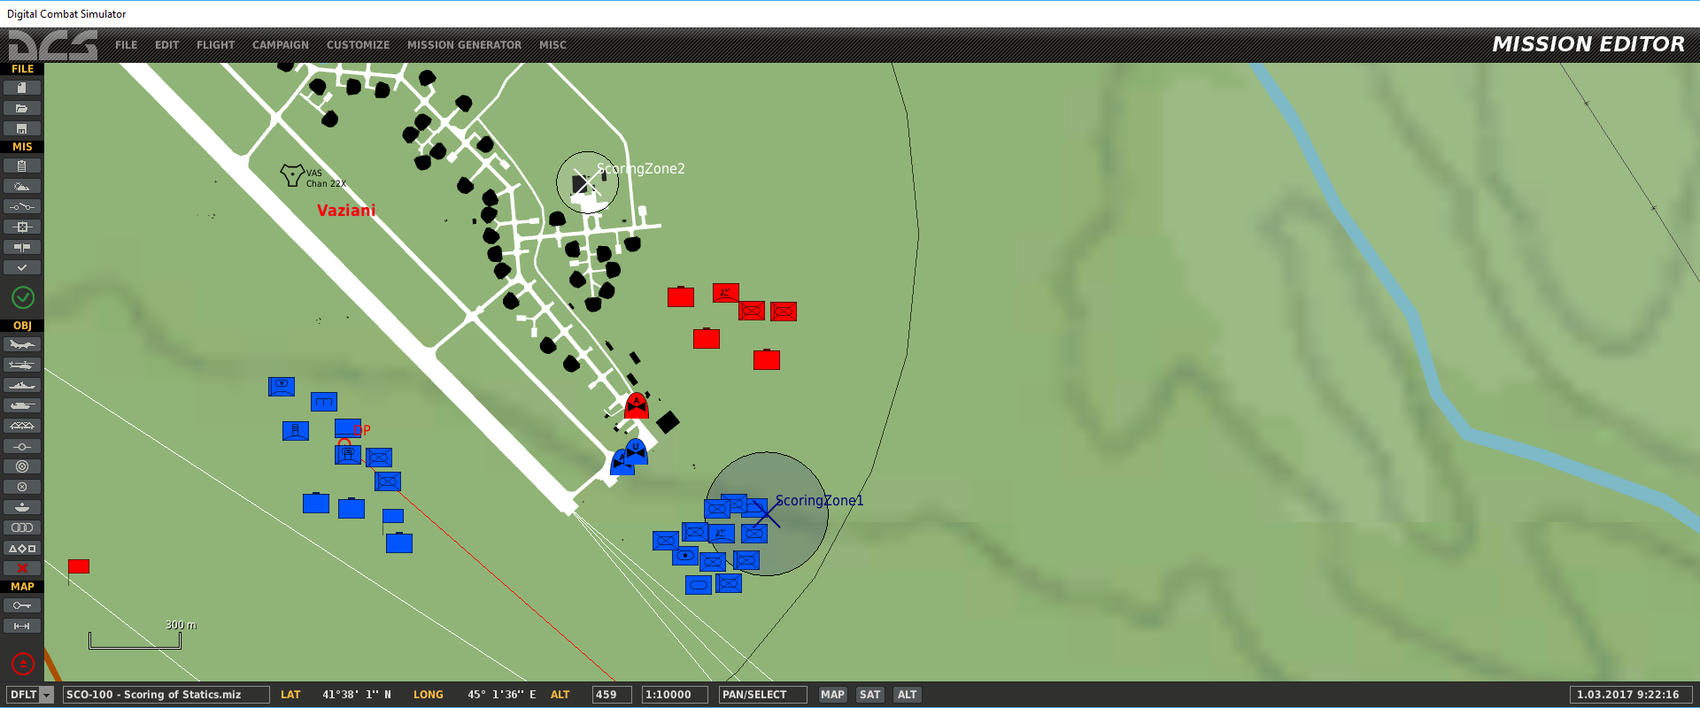
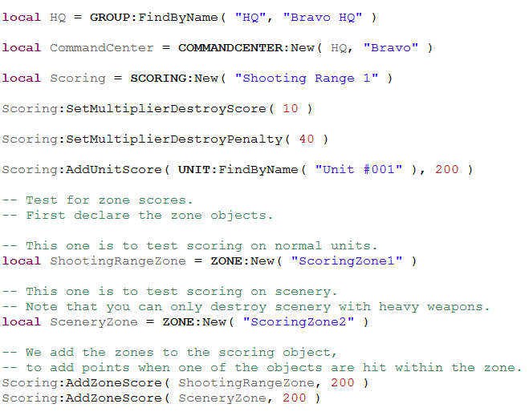
define a scoring anywhere in your mission

Slide 7
scores are granted upon hits and shared upon destroy
Destroy Score
Hit Score
Hit
Destroy
Hit
Destroy
+ Addon Score!
Assigned Target
Assigned Target

Slide 8
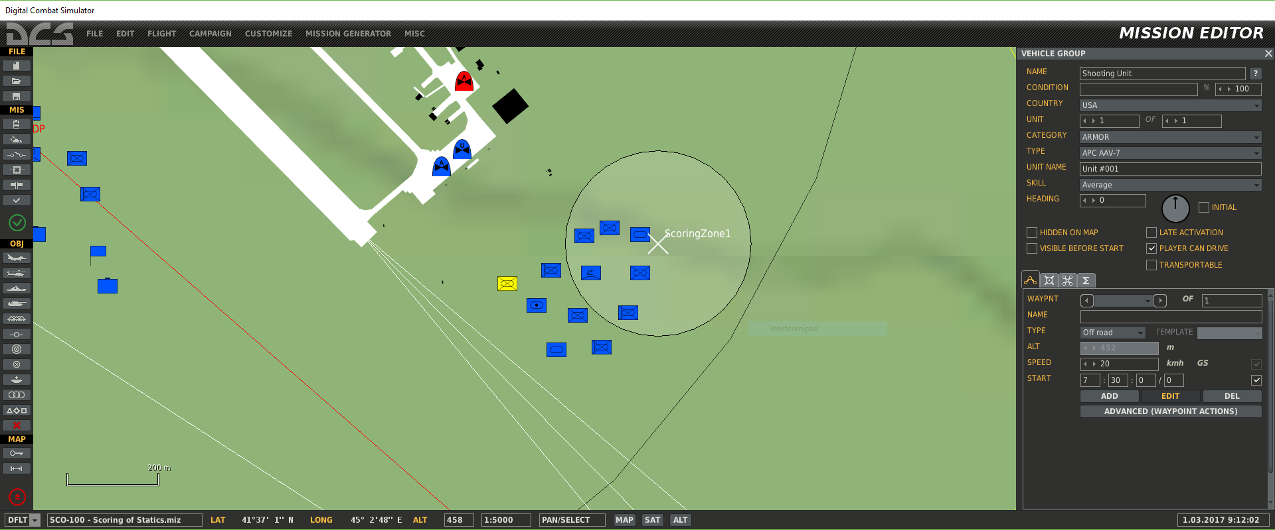
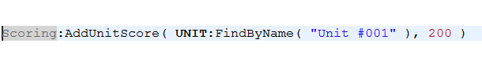
specific targets for additional score

Slide 9
zones can be defined to set assigned targets
Destroy Score
Hit Score
Hit
Destroy
Hit
Destroy
Assigned Target
in Zone
Assigned Target
in Zone
+ Addon Score!

Slide 10
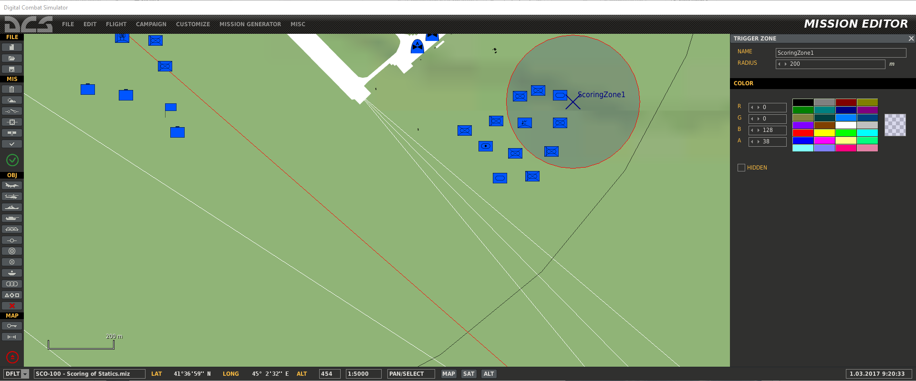
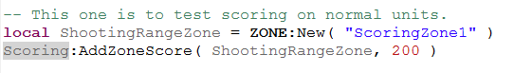
define zones for unit or static additional scores

Slide 11
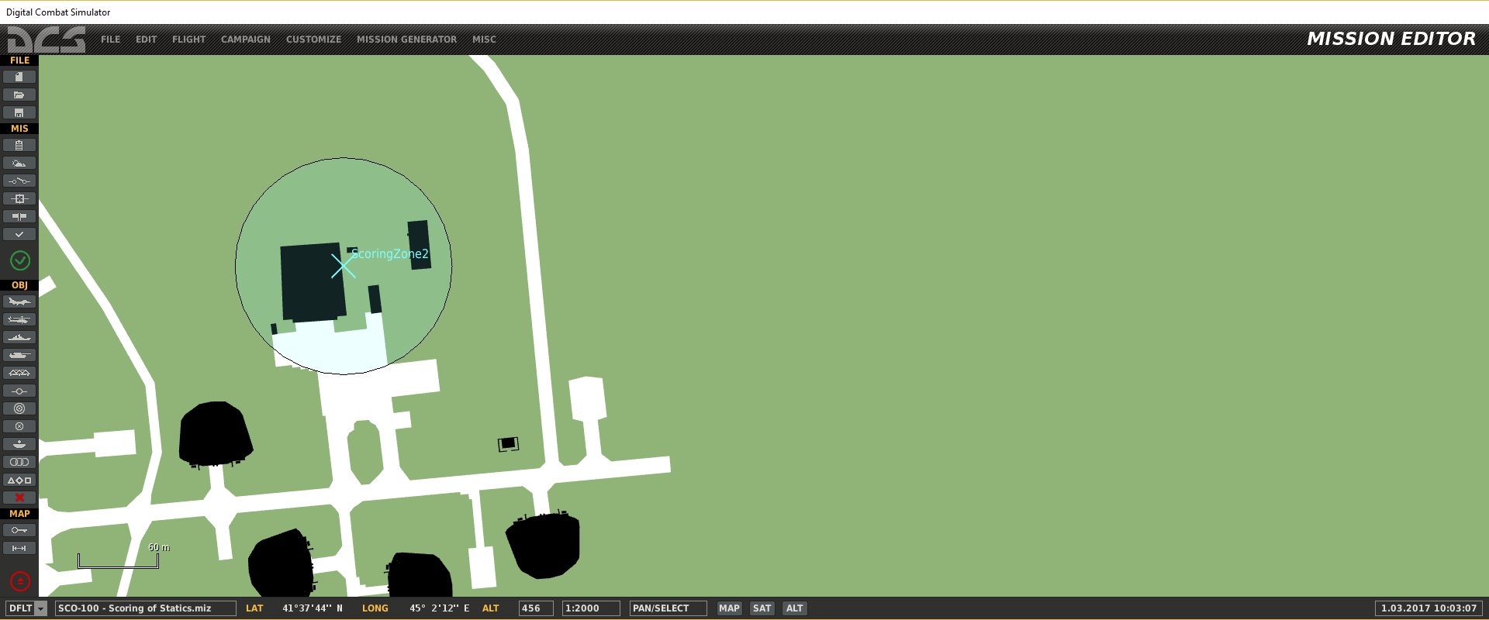
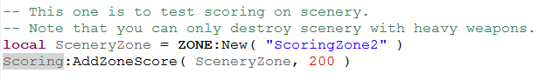
define zones for scenery targets for additional scores

Slide 12
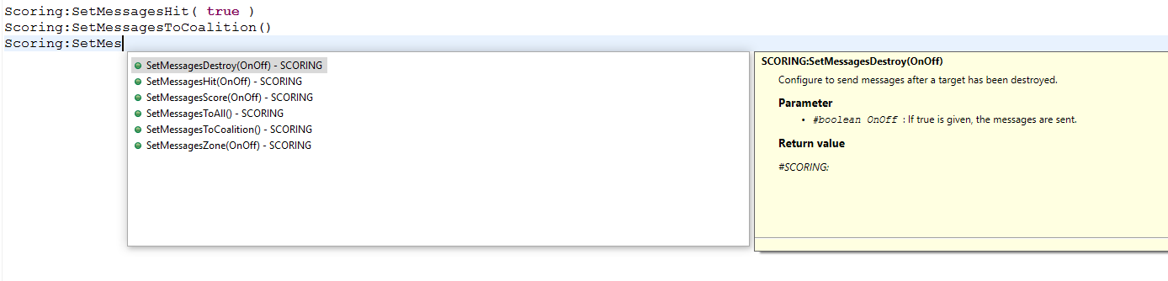
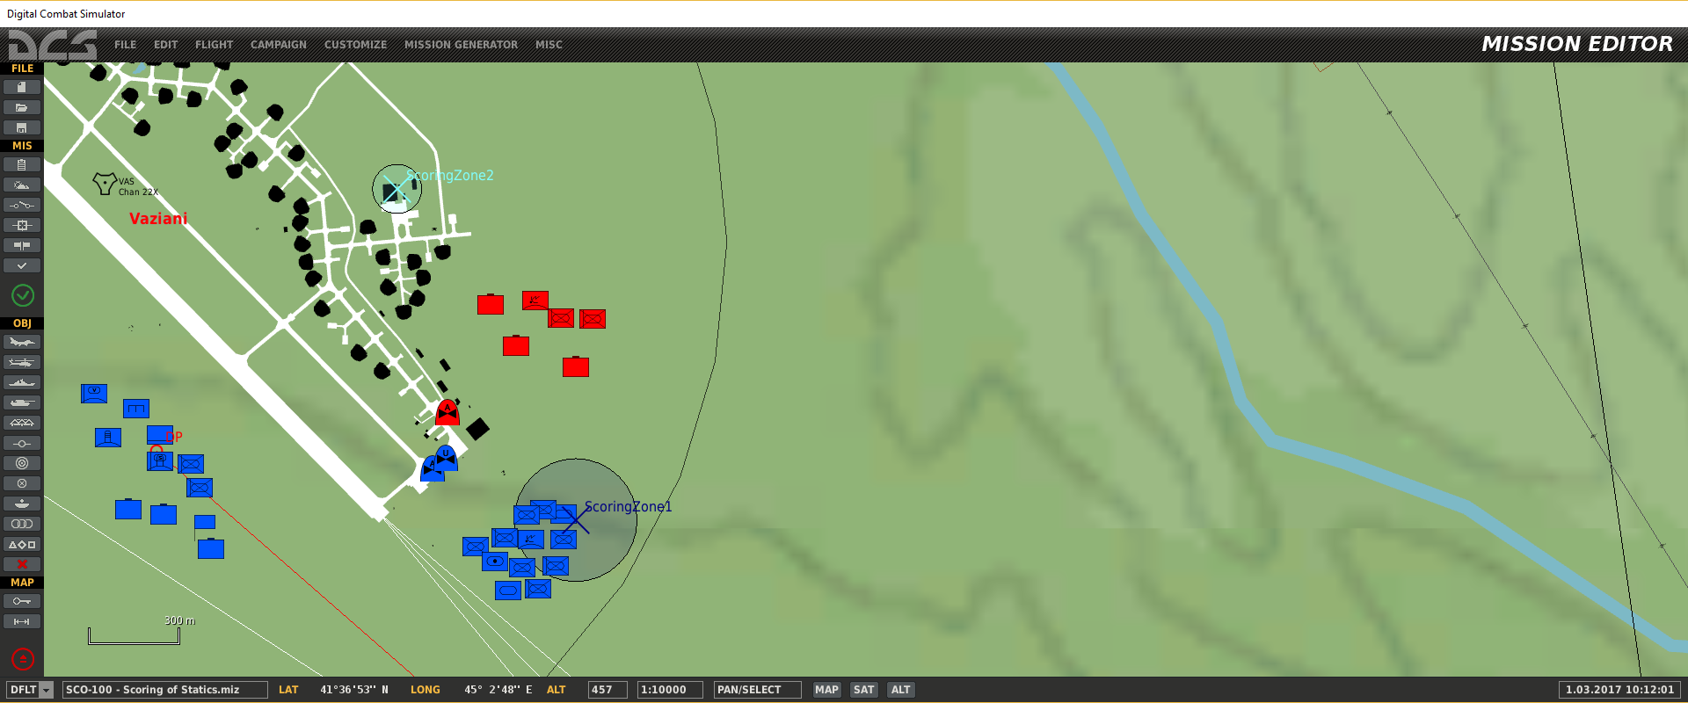
customize messages

